Slide 1


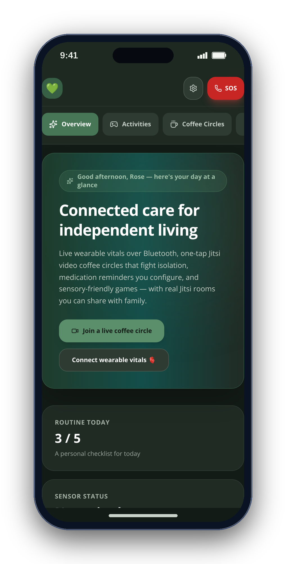
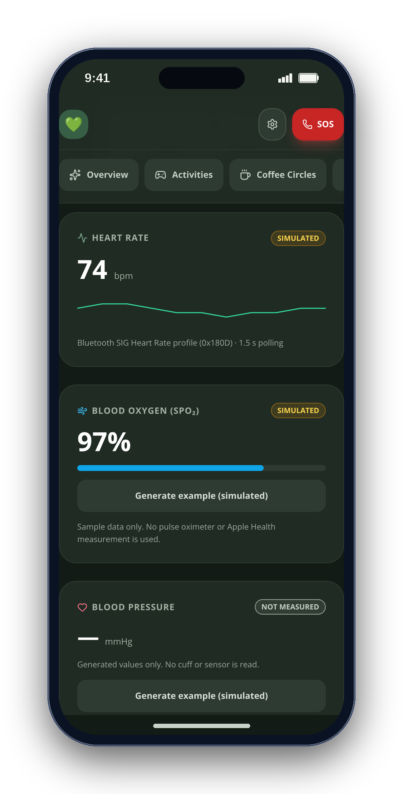
CONGRESSIONAL APP CHALLENGE 2026 · CA-10
CareSphere AI
Connected care for independent living
A private care companion for older adults, autistic people and the families who care for them.
Arnav Kochar
CA-10 · kochar4646@gmail.com
Notes:
SLIDE 1 · 0:00–0:10 · Title and purpose
SAY: I'm Arnav Kochar. CareSphere AI combines routines, self-paced activities, human connection and visit preparation for older adults, autistic people and their families.
Visuals are real CareSphere web screenshots with fictional sample data, not native iOS screenshots. No AI-generated imagery. No CareSphere clinical efficacy is established.

Slide 2
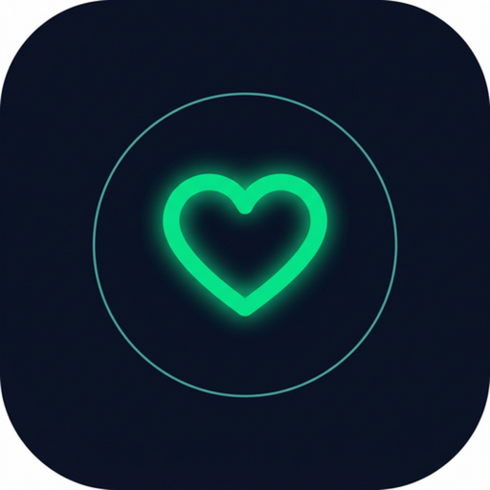
02
THE DESIGN PROBLEM
Everyday support. Less friction.
Care should not feel like another task.
A predictable day
Mood check-ins, routines and medication self-check-ins.
A low-pressure activity
Self-paced games and sensory choices.
A way to connect
Video rooms and a brief you prepare before a visit.
CareSphere AI
Notes:
SLIDE 2 · 0:10–0:20 · The design problem
SAY: Daily support should not feel like another task. CareSphere brings reminders, low-pressure activities and ways to connect into one predictable place, with the person in control.
Visuals are real CareSphere web screenshots with fictional sample data, not native iOS screenshots. No AI-generated imagery. No CareSphere clinical efficacy is established.

Slide 3
03
WHAT THE APP DOES
Daily support. Play, connect, prepare.
01
Activities & sensory tools
02
Everyday routines
Four self-paced games, breathing and optional soundscapes.
Mood check-ins, daily tasks and medication self-check-ins.
03
Human connection
04
Visit preparation
Coffee Circles open Jitsi video rooms; care notes stay local.
Choose notes and readings for a previewable visit brief.
For older adults, autistic people and the families who support them.
CareSphere AI
Notes:
SLIDE 3 · 0:20–0:32 · What the app does
SAY: There are four areas: activities and sensory tools; mood, routines and medication self-check-ins; Coffee Circles for video conversations; and a visit brief made from information you choose.
Visuals are real CareSphere web screenshots with fictional sample data, not native iOS screenshots. No AI-generated imagery. No CareSphere clinical efficacy is established.

Slide 4
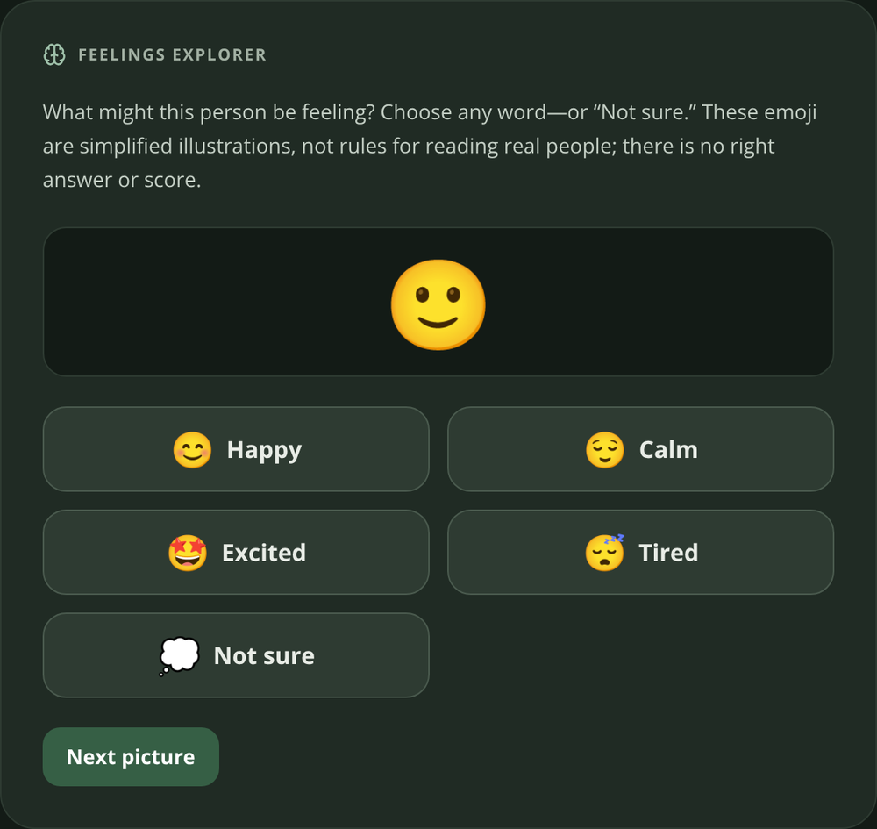
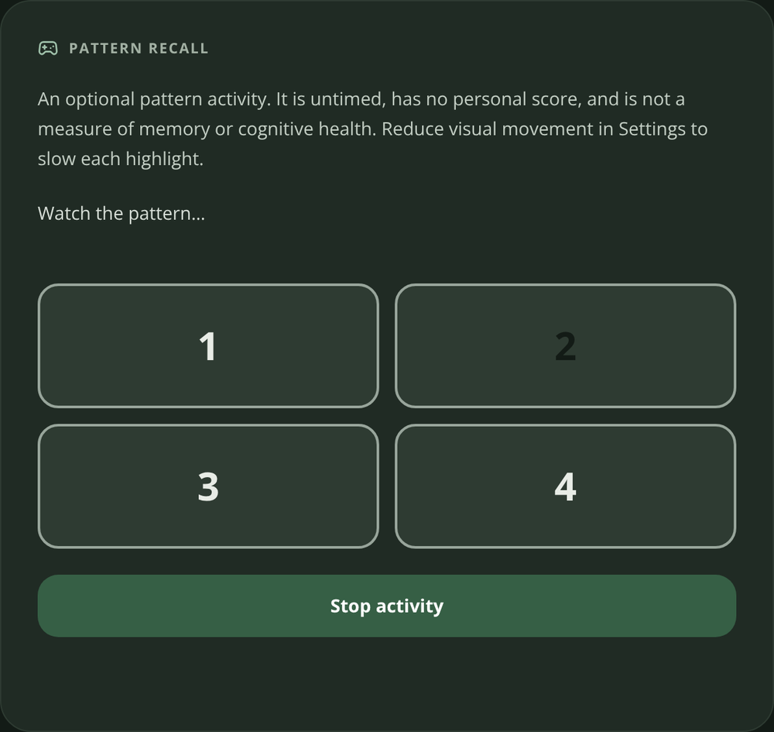
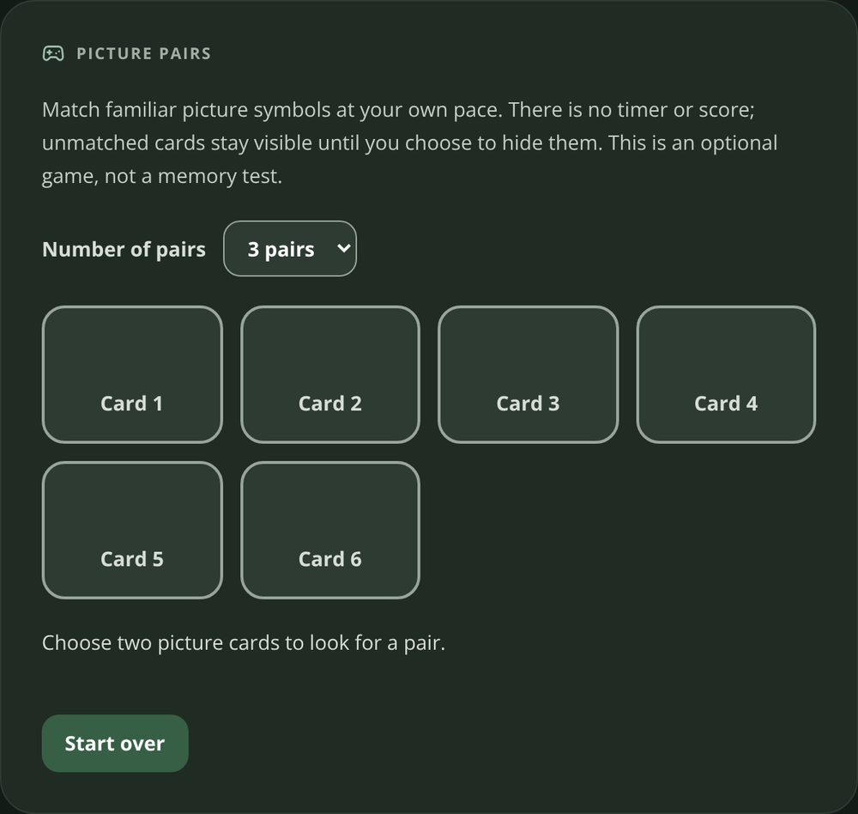
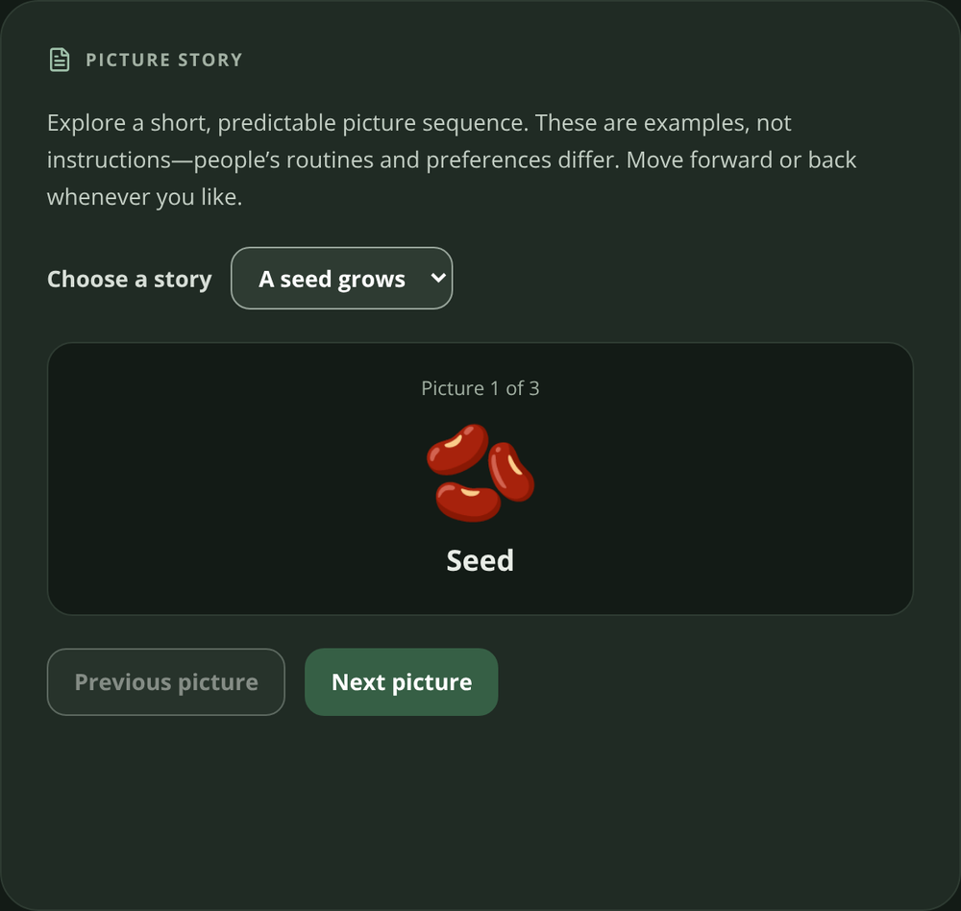
04
CORE FEATURE · GAMES
Four ways to play. At your own pace.
Feelings Explorer
Pattern Recall
Picture Pairs
Picture Story
Choose how you feel.
Watch, then repeat.
Reveal matching cards.
Explore a picture sequence.
No right or wrong answer.
Replay or stop anytime.
No countdown or score.
Advance when ready.
CareSphere AI
Notes:
SLIDE 4 · 0:32–0:46 · Four self-paced games
SAY: Feelings Explorer has no correct answer. Pattern Recall lets you repeat a sequence. Picture Pairs reveals matching cards, and Picture Story explores a sequence at your pace. All are untimed and unscored.
Visuals are real CareSphere web screenshots with fictional sample data, not native iOS screenshots. No AI-generated imagery. No CareSphere clinical efficacy is established.

Slide 5
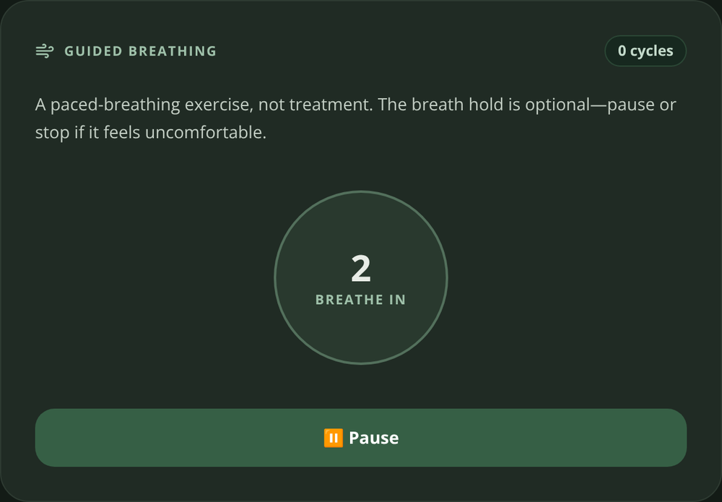
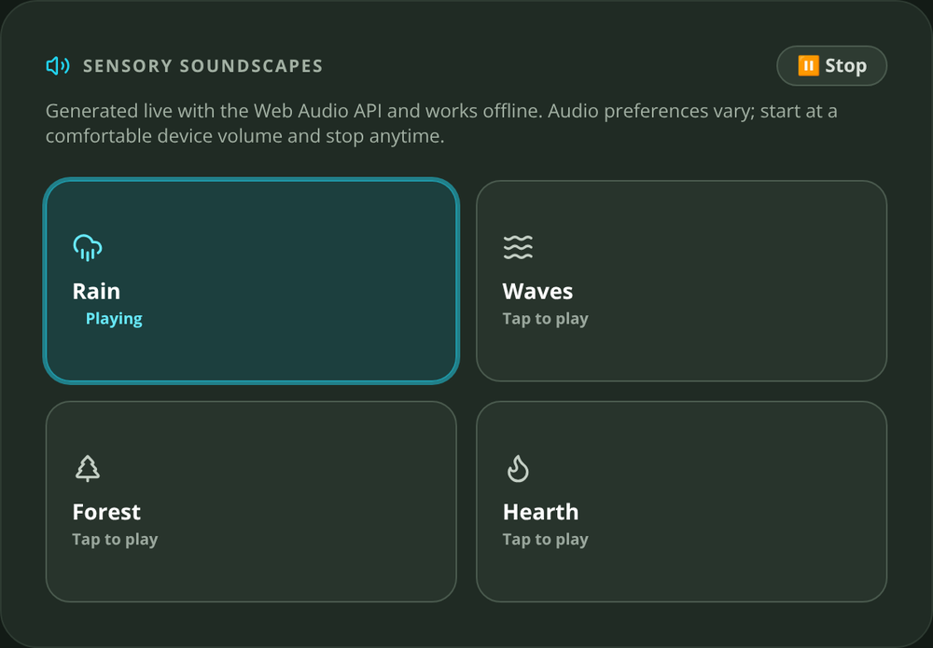
05
SENSORY TOOLS · RESEARCH-INFORMED DESIGN
A calmer experience. You choose.
Research → design
AASPIRE: predictable navigation and sensory choice.
Game studies vary. Optional practice and enjoyment — not validated therapy.
Start. Pause. Stop. At your pace.
4–4–6 breathing · four optional soundscapes
Text size, contrast, palette and motion choices.
Raymaker et al., 2019 · Alahmari et al., 2023 · Liu et al., 2025. Full references in notes and guide.
CareSphere AI
Notes:
SLIDE 5 · 0:46–0:58 · Sensory choice and research
SAY: Breathing and optional soundscapes are user-controlled. Accessibility research informed predictable navigation and sensory choices. Game research is promising but varied; these activities are not validated therapy.
Visuals are real CareSphere web screenshots with fictional sample data, not native iOS screenshots. No AI-generated imagery. No CareSphere clinical efficacy is established.
References: https://pmc.ncbi.nlm.nih.gov/articles/PMC6485264/ ; https://pmc.ncbi.nlm.nih.gov/articles/PMC9809031/ ; https://pmc.ncbi.nlm.nih.gov/articles/PMC12781649/ . These studies do not validate these CareSphere activities.

Slide 6
06
LIVE APP DEMONSTRATION
Let me show you
CareSphere in action.
Play → choose → check in → prepare
REAL APP · SAMPLE DATA
CareSphere AI
Notes:
SLIDE 6 · 0:58–1:01 · Switch to the running app
SAY: Let’s see CareSphere in action.
Visuals are real CareSphere web screenshots with fictional sample data, not native iOS screenshots. No AI-generated imagery. No CareSphere clinical efficacy is established.
ACTION: After this cue, immediately switch to the running app or genuine recorded app interaction for 80 seconds. Return at slide 7. Do not advance through static screenshots instead. See the PDF guide.

Slide 7
07
TOOLS, LANGUAGES AND PRIVACY
Two clients. Local-first care.
Web app
Native iPhone app
JavaScript
Swift
React · Vite · Web Audio
Web Bluetooth · Web Crypto
SwiftUI · HealthKit · CoreBluetooth
CryptoKit · optional local Health Guide
Encrypted local care data. Sharing is deliberate.
Jitsi calls and online references use external services. The screenshots shown are the web app.
CareSphere AI
Notes:
SLIDE 7 · 2:21–2:33 · Tools, languages and privacy
SAY: The web app uses JavaScript, React and Web Audio. The native iPhone app uses Swift and SwiftUI. Care data is encrypted locally; Jitsi calls and online references use external services.
Visuals are real CareSphere web screenshots with fictional sample data, not native iOS screenshots. No AI-generated imagery. No CareSphere clinical efficacy is established.

Slide 8
08
PROGRAMMING CHALLENGE
Old connection. Wrong reading? Not here.
A late Bluetooth callback could update a newer session.
src/App.jsx · excerpt
if (generation !==
hrConnectionGenerationRef.current)
return
Reject stale sessions
A generation counter checks which connection owns the callback.
Keep the source honest
Current session only.
Source labels remain in exports.
Every accepted sample is labeled LIVE_BLE or SIMULATED.
CareSphere AI
Notes:
SLIDE 8 · 2:33–2:45 · A specific coding challenge
SAY: Old Bluetooth callbacks could update a new session. A generation counter rejects stale callbacks. Each accepted sample stays labeled live or simulated, including when exported.
Visuals are real CareSphere web screenshots with fictional sample data, not native iOS screenshots. No AI-generated imagery. No CareSphere clinical efficacy is established.

Slide 9
09
WHAT COMES NEXT
Build with people. Then evaluate.
Co-design
Invite intended users and caregivers to review the experience.
Usability testing
Observe whether tasks are understandable and comfortable.
iPhone beta
Prepare a TestFlight beta after iteration and device testing.
Lesson: a working feature is not proof of real-world benefit.
CareSphere AI
Notes:
SLIDE 9 · 2:45–2:52 · Next step and learning
SAY: Next: co-design and usability testing. A working feature isn't proof of real-world benefit.
Visuals are real CareSphere web screenshots with fictional sample data, not native iOS screenshots. No AI-generated imagery. No CareSphere clinical efficacy is established.

Slide 10

scan for source
Care that stays yours.
Connected, calm and local-first — with real readings or clearly labeled simulation.
EXPLORE THE PROJECT
READ THE CODE
BUILD LOCALLY
github.com/engineer2025-sudo/Care
Arnav Kochar · CA-10 · kochar4646@gmail.com
Explore the source, build instructions and project documentation.
Notes:
SLIDE 10 · 2:52–2:56 · Close
SAY: CareSphere AI. Everyday support, on your terms. Thank you.
Visuals are real CareSphere web screenshots with fictional sample data, not native iOS screenshots. No AI-generated imagery. No CareSphere clinical efficacy is established.

